Slide 1
Access Control Lists (ACLs)
TRS2251
Routing and Switching
Lecture 9
Source: Rick Graziani
Cabrillo College

Slide 2


Slide 3
Lecture 8
IP ACL Operation
Standard IPv4 ACLs
Extended IPv4 ACLSs
Contextual Unit: Debug with ACLs
Troubleshoot ACLs
Contextual Unit: IPv6 ACLs
Summary

Slide 4
Lecture 8: Objectives
After completing this chapter, students will be able to:
Explain how ACLs are used to filter traffic.
Compare standard and extended IPv4 ACLs.
Explain how ACLs use wildcard masks.
Explain the guidelines for creating ACLs.
Explain the guidelines for placement of ACLs.
Configure standard IPv4 ACLs to filter traffic according to networking requirements.
Modify a standard IPv4 ACL using sequence numbers.
Configure a standard ACL to secure vty access.
Explain the structure of an extended access control entry (ACE).
Configure extended IPv4 ACLs to filter traffic according to networking requirements.
Configure an ACL to limit debug output.
Explain how a router processes packets when an ACL is applied.
Troubleshoot common ACL errors using CLI commands.
Compare IPv4 and IPv6 ACL creation.
Configure IPv6 ACLs to filter traffic according to networking requirements.

Slide 5

Access Control Lists (ACLs)

Slide 6
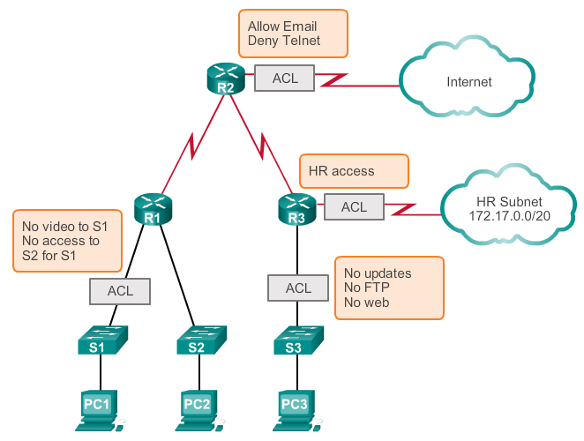
Access Control Lists (ACLs)
By default, a router does not filter traffic.
When an ACL is applied to an interface:
performs the additional task of evaluating all network packets
determines if the packet can be forwarded in or out of the interface.
1
2
4
3
Notes:
9.1.1.1 What is an ACL?

Slide 7
What are ACLs?
A router acts as a packet filter when it forwards or denies packets according to filtering rules.
Packet filtering controls access to a network by:
analyzing the incoming and outgoing packets
passing or dropping them based on given criteria
An ACL is a sequential list of of permit or deny statements, known as access control entries (ACEs).
ACEs are also commonly called ACL statements.

Slide 8
Packet Filtering
ACLs control whether a router permits or denies packets based on criteria in the header that identifies the:
Source IP address
Destination IP address
IP protocols (ICMP, TCP, UDP, EIGRP, …)
TCP/UDP source port
TCP/UDP destination port

Slide 9
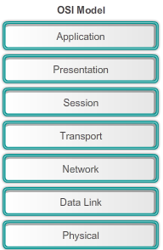

Packet Filtering
ACLs control whether a router permits or denies packets based on criteria in the header that identifies the:
Source IP address
Destination IP address
IP protocols (ICMP, TCP, UDP, EIGRP, …)
TCP/UDP source port
TCP/UDP destination port

Slide 10
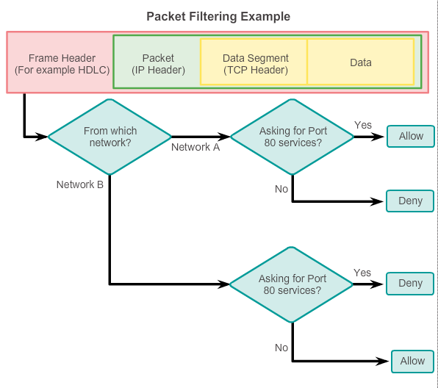

Slide 11
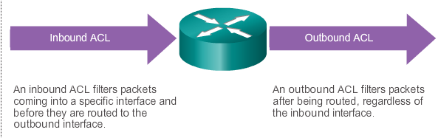

Slide 12
Types of ACLs

Slide 13


Standard ACLs
Can permit or deny traffic for Source IP addresses … only!
Extended ACLs
Can permit or deny traffic for:
Protocol type IP (IP, ICMP, EIGRP, OSPF, TCP, UDP, …)
Source IP address
Source TCP or UDP ports
Destination IP address
Destination TCP or UDP ports

Slide 14
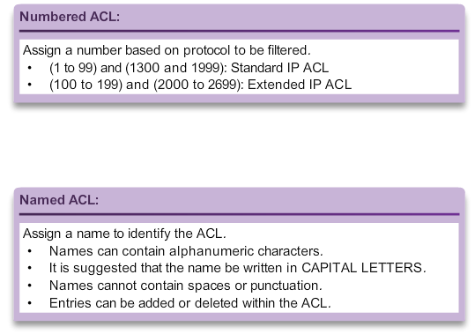
Numbered and Named ACLs

Slide 15
Wildcard Mask
Standard and Extended ACLs both use wildcard masks.
Wildcard masks and subnet masks differ in the way they match binary 1s and 0s.
Wildcard masks use the following rules to match binary 1s and 0s:
Wildcard mask bit 0 - Match the corresponding bit value in the address
Wildcard mask bit 1 - Ignore the corresponding bit value in the address

Slide 16
Calculating Wildcard Masks #1
Calculating wildcard masks can be difficult, but you can do it easily by subtracting the subnet mask from 255.255.255.255.
For example, assume you wanted to permit access to all users in the 192.168.3.0 /24
Subtract the subnet mask (255.255.255.0) from the subnet mask 255.255.255.255.
255.255.255.255
255.255.255.000
000.000.000.255
access-list 1 permit 192.168.3.0 0.0.0.255

Slide 17
Calculating Wildcard Masks #2
Assume you wanted to permit access to all users in the 192.168.3.32 /28
Subtract the subnet mask (255.255.255.240) from the subnet mask 255.255.255.255.
255.255.255.255
255.255.255.240
000.000.000.015
access-list 1 permit 192.168.3.32 0.0.0.15

Slide 18
Host keyword
access-list 1 permit 192.168.1.1 0.0.0.0
Decimal
Binary
IP Address
192.168.1.1
11000000.10101000.00000001.00000001
Wildcard Mask
0.0.0.0
00000000.000000000.00000000.00000000
Result
192.168.1.1
11000000.10101000.00000001.00000001
The host keyword can be used to substitute for the 0.0.0.0 wildcard mask.
This mask states that all IPv4 address bits must match or only one host is matched.
Note: The host keyword can also be used in IPv6 ACLs.
access-list 1 permit host 192.168.1.1

Slide 19
Any Keyword
access-list 1 permit 0.0.0.0 255.255.255.255
Decimal
Binary
IP Address
0.0.0.0
00000000.00000000.00000000.00000000
Wildcard Mask
255.255.255.255
11111111.11111111.11111111.11111111
Result
0.0.0.0
00000000.000000000.00000000.00000000
The any keyword substitutes for the 255.255.255.255 wildcard mask.
This mask says to ignore the entire IPv4 address or to accept any addresses.
Note: The any keyword can also be used in IPv6 ACLs.
access-list 1 permit any

Slide 20
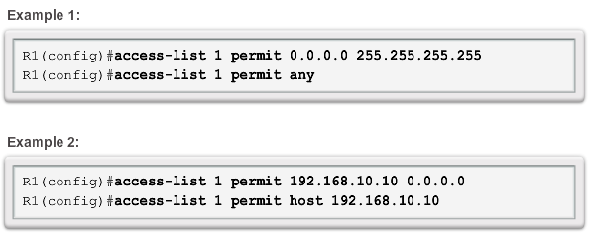
Any and Host Keywords

Slide 21
Placement of ACLs

Slide 22
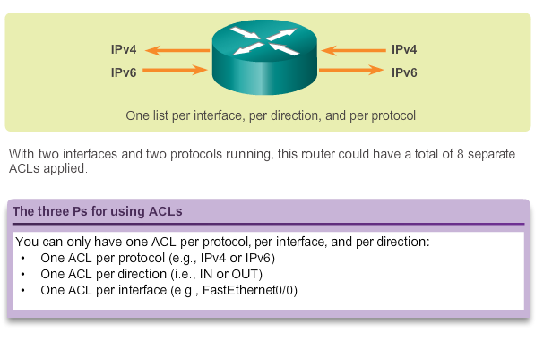
Any Traffic filtering on a Router

Slide 23
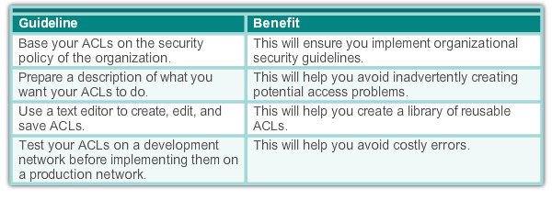
Any Best Practices

Slide 24
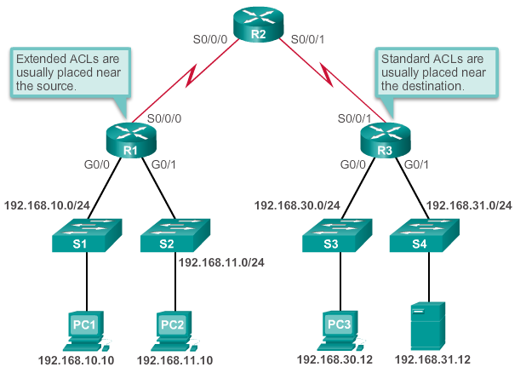
ACL Placement
Extended ACLs - This way, undesirable traffic is denied close to the source network without crossing the network infrastructure.
Standard ACLs - Because standard ACLs do not specify destination addresses, place them as close to the destination as possible.
Placing a standard ACL at the source of the traffic will effectively prevent that traffic from reaching any other networks through the interface where the ACL is applied.

Slide 25
ACL Placement
Placement of the ACL and therefore the type of ACL used may also depend on:
The extent of the network administrator’s control
Bandwidth of the networks involved
Ease of configuration
25

Slide 26
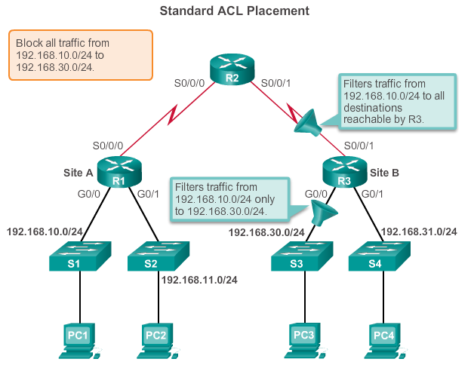

Slide 27
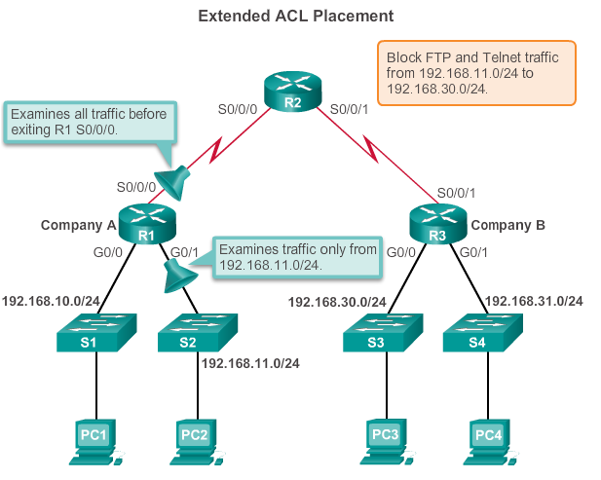
OR

Slide 28
Configuring Standard IPv4 ACLs Numbered and Named

Slide 29
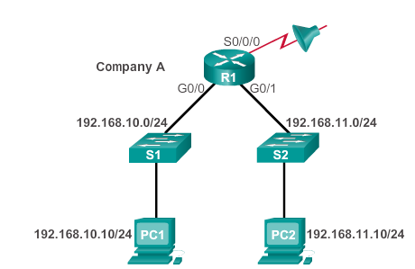
How are ACLs Created? In Two Steps!
1. Create an ACL definition.
Enter global configuration mode.
Define statements of what to filter.
2. Apply the ACL to an interface.
Enter interface configuration mode.
Identify the ACL and the direction to filter.

Slide 30
1. Create a Standard ACL
RTR(config)# access-list ACL# {permit|deny} { test-conditions }
access-list 5 permit 172.34.54.34 0.0.0.0
ACL-# is a unique identifier.
The # range identifies the type of ACL.
permit | deny are terms to specify how the packets which meet the condition will be handled.
permit: Implies the packet will not be filtered.
deny: Implies the packet will be filtered.
remark: Allows you to enter a description of the ACL

Slide 31
2. Apply the ACL to an interface
RTR(config-if)# {protocol} access-group list-# {in|out}
ip access-group 5 out
in | out identifies if the ACL is for incoming or outgoing traffic.
in means that packets are filtered as they enter the interface, before the routing decision.
out means that packets are filtered as they leave the interface, after the routing decision.
“out” is the default.
Outbound ACLs are generally more efficient, and are preferred.
Inbound ACLs must check every packet.

Slide 32
By default, there is an implied deny at the end of all ACLs for traffic that was not matched to a configured entry.
R1(config)# access-list 1 permit ip 192.168.10.0 0.0.0.255
SAME AS
R1(config)# access-list 2 permit ip 192.168.10.0 0.0.0.255
R1(config)# access-list 2 deny any

Slide 33
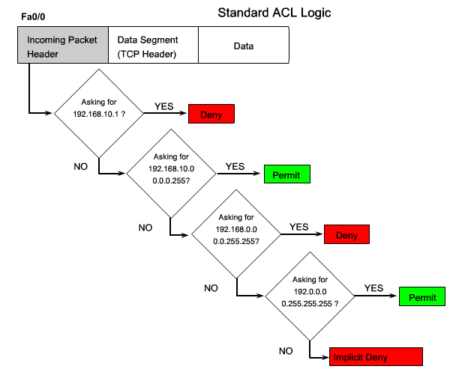

Slide 34
Removing an ACL
R1(config)# access-list 10 permit 192.168.10.0 0.0.0.255
R1(config)# exit
R1# show access-lists
Standard IP access list 10
10 permit 192.168.10.0, wildcard bits 0.0.0.255
R1# conf t
Enter configuration commands, one per line. End with CNTL/Z.
R1(config)# no access-list 10
R1(config)# exit
R1 #show access-lists
R1#
Notes:
Media Description:
Use 3 button graphic from powerpoint

Slide 35
Comments - remark
R1(config)# access-list 10 remark Permit hosts from the 192.168.10.0 LAN
R1(config)# access-list 10 permit 192.168.10.0 0.0.0.255
R1(config)# exit
R1# show running-config | include access-list 10
access-list 10 remark Permit hosts from the 192.168.10.0 LAN
access-list 10 permit 192.168.10.0 0.0.0.255
R1#
Notes:
Media Description:
Use graphic from powerpoint

Slide 36
Internal Logic Order matters
Conflict with Statements
ACL 3: Host statement conflicts with previous range statement
R1(config)# access-list 3 deny 192.168.10.0 0.0.0.255
R1(config)# access-list 3 permit host 192.168.10.10
% Access rule can't be configured at higher sequence num as it is part of the existing rule at sequence num 10
R1(config)#
Notes:
Media Description:
Use graphic in powerpoint

Slide 37
Internal Logic Order matters
Host Statement Entered Before Range
ACL 4: Host statement can always be configured before range statements
R1(config)# access-list 4 permit host 192.168.10.10
R1(config)# access-list 4 deny 192.168.10.0 0.0.0.255
R1(config)#
Notes:
Media Description:
Use graphic in powerpoint

Slide 38
Internal Logic Order matters
Host Configured Before Range with no Conflict
ACL 5: Host statement can be configured after range statement if there is no conflict
R1(config)# access-list 5 deny 192.168.10.0 0.0.0.255
R1(config)# access-list 5 permit host 192.168.11.10
R1(config)#
Notes:
Media Description:
Use graphic in powerpoint

Slide 39
Applying Standard ACLs to Interfaces
Step 1: Configure the ACL statements
R1(config)# access-list 1 permit 192.168.10.0 0.0.0.255
Step 2: Select the interface to apply the ACL
R1(config)# interface serial 0/0/0
Step 3: Apply the ACL to the interface using the ip access-group command
R1(config-if)# ip access-group 1 out

Slide 40
Permit a Specific Subnet
R1(config)# access-list 1 permit 192.168.10.0 0.0.0.255
R1(config)# interface s0/0/0
R1(config-if)# ip access-group 1 out

Slide 41
Deny a Specific Host and Permit a Specific Subnet
X
X
R1(config)# access-list 1 deny host 192.168.10.10
R1(config)# access-list 1 permit 192.168.10.0 0.0.0.255
R1(config)# interface s0/0/0
R1(config-if)# ip access-group 1 out

Slide 42
Deny a Specific Host
X
R1(config)# access-list 1 deny host 192.168.10.10
R1(config)# access-list 1 permit any
R1(config)# interface g0/0
R1(config-if)# ip access-group 1 in

Slide 43
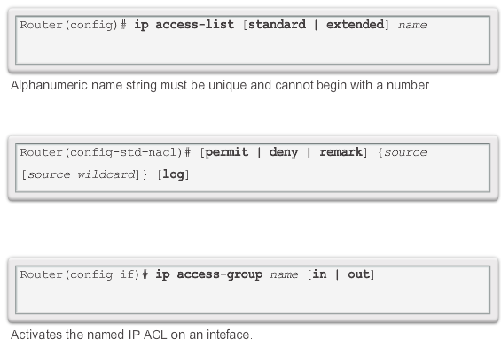
Named ACL

Slide 44
Named ACLs
RTR(config)# ip access-list {standard|extended} { NAME }
ip access-list extended TELNET-FILTER
Named ACLs allow standard and extended IP ACLs to be identified with an alphanumeric string (name) instead of the current numeric representation.
Name cannot start with a number.
Named ACLs help identify the function of the ACL.
The actual names used must be unique across all named access lists of all protocols and types on an individual router.
Names can be duplicated on different routers.
ACLs of different types cannot have the same name.
For example, it is illegal to specify a standard ACL named BOB and an extended ACL with the same name.

Slide 45
Named ACLs Syntax
RTR(config)# ip access-list {standard|extended} { NAME }
ip access-list extended TELNET-FILTER
You create the named ACL in global configuration mode.
Notice that the access-list command has changed to:
ip access-list
You then enter named ACL configuration mode.
The sub config mode prompt varies between standard and extended ACLs.
R1(config)# ip access-list standard STANDARD-ACL
R1(config-std-nacl)# exit
R1(config)# ip access-list extended EXT-ACL
R1(config-ext-nacl)# exit

Slide 46
Named ACLs Syntax
In ACL configuration mode, specify one or more conditions permitted or denied.
This determines whether the packet is passed or dropped.
RTR(config {std- | ext-}nacl)# deny {source [source wildcard] | any}
RTR(config {std- | ext-}nacl)# permit {source [source wildcard] | any}
RTR(config {std- | ext-}nacl)# remark [comment]

Slide 47
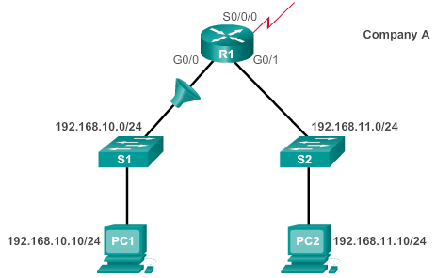
Named ACL Example
X
R1(config)# ip access-list standard NO_ACCESS
R1(config-std-nacl)# deny host 192.168.11.10
R1(config-std-nacl)# permit any
R1(config-std-nacl)# exit
R1(config)# interface g0/0
R1(config-if)# ip access-group NO_ACCESS out

Slide 48
Commenting ACLs
Example 1 – Commenting a numbered ACL
R1(config)# access-list 1 remark Do not allow Guest workstation through
R1(config)# access-list 1 deny host 192.168.10.10
R1(config)# access-list 1 remark Allow devices from all other 192.168.x.x subnets
R1(config)# access-list 1 permit 192.168.0.0 0.0.255.255
R1(config)# interface s0/0/0
R1(config-if)# ip access-group 1 out
R1(config-if)#
Example 2 – Commenting a named ACL
R1(config)# ip access-list standard NO_ACCESS
R1(config-std-nacl)# remark Do not allow access from Lab workstation
R1(config-std-nacl)# deny host 192.168.11.10
R1(config-std-nacl)# remark Allow access from all other networks
R1(config-std-nacl)# permit any
R1(config-std-nacl)# interface G0/0
R1(config-if)# ip access-group NO_ACCESS out
R1(config-if)#
Notes:
Media Description:
Use graphic from powerpoint

Slide 49
Editing Numbered ACLs Using Sequence Numbers
Configuration
R1(config)# access-list 1 deny host 192.168.10.99
R1(config)# access-list 1 permit 192.168.0.0 0.0.255.255
Step 1
R1# show access-lists 1
Standard IP access list 1
10 deny 192.168.10.99
20 permit 192.168.0.0, wildcard bits 0.0.255.255
R1#
Step 2
R1# conf t
R1(config)# ip access-list standard 1
R1(config-std-nacl)# no 10
R1(config-std-nacl)# 10 deny host 192.168.10.10
R1(config-std-nacl)# end
R1#
Step 3
R1# show access-lists
Standard IP access list 1
10 deny 192.168.10.10
20 permit 192.168.0.0, wildcard bits 0.0.255.255
R1#
Notes:
Media Description:
Use graphic from powerpoint

Slide 50
Editing Named ACLs – Adding a Line
R1# show access-lists
Standard IP access list NO_ACCESS
10 deny 192.168.11.10
20 permit 192.168.11.0, wildcard bits 0.0.0.255
R1# conf t
Enter configuration commands, one per line. End with CNTL/Z.
R1(config)# ip access-list standard NO_ACCESS
R1(config-std-nacl)# 15 deny host 192.168.11.11
R1(config-std-nacl)# end
R1# show access-lists
Standard IP access list NO_ACCESS
10 deny 192.168.11.10
15 deny 192.168.11.11
20 permit 192.168.11.0, wildcard bits 0.0.0.255
R1#
Note: The no sequence-number named-ACL command is used to delete individual statements.
Notes:
Media Description:
Use 2 button graphic powerpoint

Slide 51
Verifying ACLs
R1# show ip interface s0/0/0
Serial0/0/0 is up, line protocol is up
Internet address is 10.1.1.1/30
<output omitted>
Outgoing access list is 1
Inbound access list is not set
<output omitted>
R1# show ip interface g0/0
GigabitEthernet0/1 is up, line protocol is up
Internet address is 192.168.10.1/24
<output omitted>
Outgoing access list is NO_ACCESS
Inbound access list is not set
<output omitted>
Notes:
Media Description:
Use graphic in powerpoint

Slide 52
Verifying ACLs
R1# show access-lists
Standard IP access list 1
10 deny 192.168.10.10
20 permit 192.168.0.0, wildcard bits 0.0.255.255
Standard IP access list NO_ACCESS
15 deny 192.168.11.11
10 deny 192.168.11.10
20 permit 192.168.11.0, wildcard bits 0.0.0.255
R1#
Notes:
Media Description:
Use graphic in powerpoint

Slide 53
Viewing ACL Statistics
R1# show access-lists
Standard IP access list 1
10 deny 192.168.10.10 (4 match(es))
20 permit 192.168.0.0, wildcard bits 0.0.255.255
Standard IP access list NO_ACCESS
15 deny 192.168.11.11
10 deny 192.168.11.10 (4 match(es))
20 permit 192.168.11.0, wildcard bits 0.0.0.255
R1#
Output after pinging PC3 from PC1.
Matches have been incremented.
R1# show access-lists
Standard IP access list 1
10 deny 192.168.10.10 (8 match(es))
20 permit 192.168.0.0, wildcard bits 0.0.255.255
Standard IP access list NO_ACCESS
15 deny 192.168.11.11
10 deny 192.168.11.10 (4 match(es))
20 permit 192.168.11.0, wildcard bits 0.0.0.255
R1#
Notes:
Media Description:
Use graphic in powerpoint

Slide 54
Clearing ACL Statistics
R1#show access-lists
Standard IP access list 1
10 deny 192.168.10.10 (8 match(es))
20 permit 192.168.0.0, wildcard bits 0.0.255.255
Standard IP access list NO_ACCESS
15 deny 192.168.11.11
10 deny 192.168.11.10 (4 match(es))
20 permit 192.168.11.0, wildcard bits 0.0.0.255
R1#
R1#clear access-list counters 1
R1#
R1#show access-lists
Standard IP access list 1
10 deny 192.168.10.10
20 permit 192.168.0.0, wildcard bits 0.0.255.255
Standard IP access list NO_ACCESS
15 deny 192.168.11.11
10 deny 192.168.11.10 (4 match(es))
20 permit 192.168.11.0, wildcard bits 0.0.0.255
Matches have been cleared.
Notes:
Media Description:
Use graphic in powerpoint

Slide 55
Standard ACL Sequence Numbers and Internal Logic
R1(config)#access-list 1 deny 192.168.10.0 0.0.0.255
R1(config)#access-list 1 deny 192.168.20.0 0.0.0.255
R1(config)#access-list 1 deny 192.168.30.0 0.0.0.255
R1(config)#access-list 1 permit 10.0.0.1
R1(config)#access-list 1 permit 10.0.0.2
R1(config)#access-list 1 permit 10.0.0.3
R1(config)#access-list 1 permit 10.0.0.4
R1(config)#access-list 1 permit 10.0.0.5
R1(config)#end
R1#show running-config | include access-list 1
access-list 1 permit 10.0.0.2
access-list 1 permit 10.0.0.3
access-list 1 permit 10.0.0.1
access-list 1 permit 10.0.0.4
access-list 1 permit 10.0.0.5
access-list 1 deny 192.168.10.0 0.0.0.255
access-list 1 deny 192.168.20.0 0.0.0.255
access-list 1 deny 192.168.30.0 0.0.0.255
R1#
Range (network) statements
Host statements (no conflicts
Host statements (no conflicts
Range (network) statements
Notes:
Media Description:
Use graphic in powerpoint

Slide 56
Standard ACL Sequence Numbers After Reload
R1#show access-lists 1
Standard IP access list 1
50 permit 10.0.0.2
60 permit 10.0.0.3
40 permit 10.0.0.1
70 permit 10.0.0.4
80 permit 10.0.0.5
10 deny 192.168.10.0, wildcard bits 0.0.0.255
20 deny 192.168.20.0, wildcard bits 0.0.0.255
30 deny 192.168.30.0, wildcard bits 0.0.0.255
R1#copy running-config startup-config
R1#reload
R1#show access-lists 1
Standard IP access list 1
10 permit 10.0.0.2
20 permit 10.0.0.3
30 permit 10.0.0.1
40 permit 10.0.0.4
50 permit 10.0.0.5
60 deny 192.168.10.0, wildcard bits 0.0.0.255
70 deny 192.168.20.0, wildcard bits 0.0.0.255
80 deny 192.168.30.0, wildcard bits 0.0.0.255
R1#
Host statements are listed first, in an order to be efficiently processed by the IOS keeping the original sequence numbers assigned by IOS
Range statements are listed after host statements, in the order they were entered, also with original sequence numbers
Notes:
Media Description:
Use graphic in powerpoint

Slide 57
Securing VTY Ports with Standard IPv4 ACLs

Slide 58
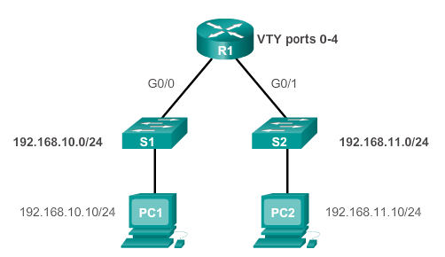
X
R1(config)# line vty 0 4
R1(config-line)# login local
R1(config-line)# transport input ssh
R1(config-line)# access-class 21 in
R1(config-line)# exit
R1(config)# access-list 21 permit 192.168.10.0 0.0.0.255
R1(config)# access-list 21 deny any

Slide 59
R1#show access-lists
Standard IP access list 21
10 permit 192.168.10.0, wildcard bits 0.0.0.255 (2 matches)
20 deny any (1 match)
R1#
X
PC1>ssh 192.168.10.1
Login as: admin
Password: *****
R1>
PC2>ssh 192.168.11.1
ssh connect to host 192.168.11.1 port 22: Connection refused
PC2>

Slide 60
Configuring Extended IPv4 ACLs Numbered and Named

Slide 61
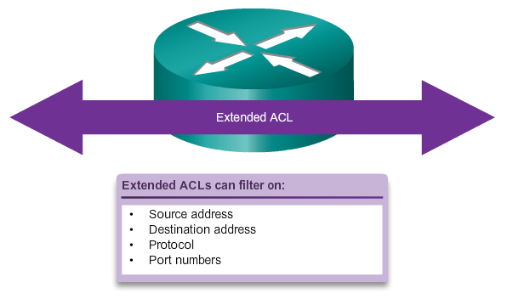

Slide 62
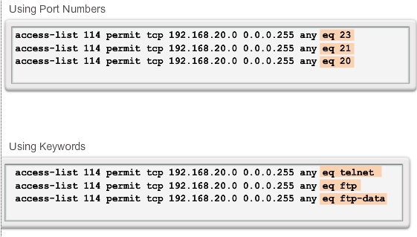

Slide 63
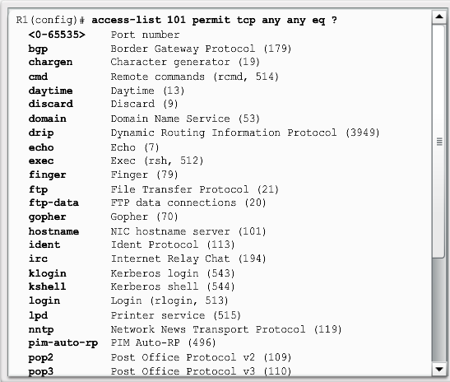

Slide 64
Extended ACLs
Extended ACLs are used more often than standard ACLs because they provide a greater degree of control. Extended ACLs provide more precise traffic-filtering control.
Also referred to as “increased granular control”.
All extended ACLs filter on Source IP address AND Destination IP address.
But what make them really special is that they can also filter based on:
Upper layer protocols (e.g., IP, TCP, UDP, ICMP, EIGRP, …)
Source port
Destination port

Slide 65
Extended ACLs Syntax
Extended ACLs also filter on Protocol and Destination address.
All extended ACLs follow this basic syntax.
The choice of Protocol adds various other options.
access-list
list-#
permit
deny
remark
Protocol
Source
Destination
Operator
Port
IP
Wildcard
IP
Wildcard
100-199
2000 to 2699
IP
TCP
UDP
ICMP
EIGRP
OSPF
any
host
any
host
LT
GT
EQ
NEQ
20 (FTP-data)
21 (FTP)
23 (TELNET)
25 (SMTP)
53 (DNS)
80 (HTTP)
These options change depending which Protocol is selected.

Slide 66
Port Names versus Port Number
access-list 114 permit tcp 192.168.20.0 0.0.0.255 any eq 23
access-list 114 permit tcp 192.168.20.0 0.0.0.255 any eq 21
access-list 114 permit tcp 192.168.20.0 0.0.0.255 any eq 20
access-list 114 permit tcp 192.168.20.0 0.0.0.255 any eq telnet
access-list 114 permit tcp 192.168.20.0 0.0.0.255 any eq ftp
access-list 114 permit tcp 192.168.20.0 0.0.0.255 any eq ftp-data
Port/protocol after destination address refers to the destination port
Note:
Not all protocols have a port name assigned
Port numbers always work.
E.g., SSH and HTTPS do not have port names assigned and must therefore be assigned using their respective port numbers (22 and 443)
Use ? examples.

Slide 67
Extended IP ACLs Examples
IP is for the entire protocol suite so port numbers cannot be specified.
access-list 101 permit ip any any
Permit all packets
access-list 101 deny ip any host 10.1.1.1
Deny all packets from any source address going specifically to host 10.1.1.1.
access-list 101 deny ip host 10.1.1.1 any
Deny all packets from host 10.1.1.1 going to any destination address.

Slide 68
Extended TCP ACLs Examples
access-list 101 deny tcp any any eq telnet
Deny packets from any source address telnetting to anywhere.
access-list 101 deny tcp any host 10.1.1.1 eq 23
Deny packets from any source address telnetting to 10.1.1.1.
access-list 101 deny tcp any host 10.1.1.1 eq telnet
Same function as last example; except it denies using the keyword telnet.

Slide 69
Extended TCP ACLs Examples
Port/protocol after source address refers to the source port
access-list 101 deny tcp any eq telnet any
Any TCP packets whose source port is 23 are denied access to any destination.
Port/protocol after destination address refers to the destination port
access-list 101 permit tcp 192.168.32.0 0.0.31.255 any eq 20
access-list 101 permit tcp 192.168.32.0 0.0.31.255 any eq 21
Packets from subnets 192.168.32.0 to 192.168.63.0 are permitted FTP access to any destination.
FTP requires both ports to be permitted. - Port 20 = ftp-data - Port 21 = ftp (commands)

Slide 70




Configuring Extended ACLs
S0/1/0
S0/0/0
R2
S0/0/1
ISP
S0/0/0
S0/0/1
10.1.1.1/30
R1
R3
G0/1
G0/0
192.168.10.0/24
192.168.11.0/24
S1
S2
R1(config)# access-list 103 permit tcp 192.168.10.0 0.0.0.255 any eq 80
R1(config)# access-list 103 permit tcp 192.168.10.0 0.0.0.255 any eq 443
R1(config)# access-list 104 permit tcp any 192.168.10.0 0.0.0.255 established
The established parameter allows only responses to traffic that originates from the 192.168.10.0/24 network to return to that network.
Without the established parameter in the ACL statement, clients could send traffic to a web server, but not receive traffic returning from the web server.
Notes:
Media Description:
Use 2 button graphic powerpoint based on E4-5.3.2.1
Configuring Extended ACLs: Use graphic from powerpoint

Slide 71
Applying Extended ACLs to Interfaces
S0/1/0
S0/0/0
R2
S0/0/1
ISP
S0/0/0
S0/0/1
10.1.1.1/30
R1
R3
G0/1
G0/0
192.168.10.0/24
192.168.11.0/24
S1
S2
R1(config)# access-list 103 permit tcp 192.168.10.0 0.0.0.255 any eq 80
R1(config)# access-list 103 permit tcp 192.168.10.0 0.0.0.255 any eq 443
R1(config)# access-list 104 permit tcp any 192.168.10.0 0.0.0.255 established
R1(config)#interface g0/0
R1(config-if)# ip access-group 103 in
R1(config-if)# ip access-group 104 out
Notes:
Media Description:
Use graphic in powerpoint (based on E4-5.3.3.1)

Slide 72

Deny FTP and Permit Everything Else
S0/1/0
S0/0/0
R2
S0/0/1
ISP
S0/0/0
S0/0/1
10.1.1.1/30
R1
R3
G0/1
G0/0
192.168.10.0/24
192.168.11.0/24
S1
S2
FTP X
R1(config)# access-list 101 deny tcp 192.168.11.0 0.0.0.255 192.168.10.0 0.0.0.255 eq ftp
R1(config)# access-list 101 deny tcp 192.168.11.0 0.0.0.255 192.168.10.0 0.0.0.255 eq ftp-data
R1(config)# access-list 101 permit ip any any
R1(config)# interface g0/1
R1(config-if)# ip access-group 101 in
Notes:
Media Description:
Use graphic in powerpoint (based on E4-5.3.3.1)

Slide 73
Deny Telnet and Permit Everything Else
S0/1/0
S0/0/0
R2
S0/0/1
ISP
Extended ACL to Deny Telnet
S0/0/0
S0/0/1
10.1.1.1/30
R1
R3
G0/1
G0/0
192.168.10.0/24
192.168.11.0/24
192.168.11.0/24
S1
Telnet X
S2
S2
R1(config)# access-list 102 deny tcp 192.168.11.0 0.0.0.255 any eq 23
R1(config)# access-list 102 permit ip any any
R1(config)# interface g0/1
R1(config-if)# ip access-group 102 out
Notes:
Media Description:
Use graphic in powerpoint (based on E4-5.3.3.1)

Slide 74

Creating Named Extended ACLs
S0/1/0
S0/0/0
R2
S0/0/1
ISP
S0/0/0
S0/0/1
10.1.1.1/30
R1
R3
G0/1
G0/0
192.168.10.0/24
192.168.11.0/24
S1
S2
R1(config)# ip access-list extended SURFING
R1(config-ext-nacl)# permit tcp 192.168.10.0 0.0.0.255 any eq 80
R1(config-ext-nacl)# permit tcp 192.168.10.0 0.0.0.255 any eq 443
R1(config-ext-nacl)# exit
R1(config)# ip access-list extended BROWSING
R1(config-ext-nacl)# permit tcp any 192.168.10.0 0.0.0.255 established
R1(config-ext-nacl)# exit
R1(config)# interface g0/0
R1(config-if)# ip access-group SURFING in
R1(config-if)# ip access-group BROWSING out
Notes:
Media Description:
Use graphic from powerpoint

Slide 75
Verifying Extended ACLs
R1#show access-lists
Extended IP access list BROWSING
10 permit tcp any 192.168.10.0 0.0.0.255 established
Extended IP access list SURFING
10 permit tcp 192.168.10.0 0.0.0.255 any eq www
20 permit tcp 192.168.10.0 0.0.0.255 any eq 443
R1#
R1#show ip interface g0/0
GigabitEthernet0/0 is up, line protocol is up
Internet address is 192.168.10.1/24
<output omitted for brevity>
Outgoing access list is BROWSING
Inbound access list is SURFING
<rest of output omitted for brevity>
Notes:
Media Description:
Use graphic in powerpoint

Slide 76
Editing Extended ACLs
R1# show access-lists
Extended IP access list BROWSING
10 permit tcp any 192.168.10.0 0.0.0.255 established
Extended IP access list SURFING
10 permit tcp 192.168.11.0 0.0.0.255 any eq www
20 permit tcp 192.168.10.0 0.0.0.255 any eq 443
R1#
R1# configure terminal
R1(config)# ip access-list extended SURFING
R1(config-ext-nacl)# no 10
R1(config-ext-nacl)# 10 permit tcp 192.168.10.0 0.0.0.255 any eq www
R1(config-ext-nacl)# exit
R1#
R1#show access-lists
Extended IP access list BROWSING
10 permit tcp any 192.168.10.0 0.0.0.255 established
Extended IP access list SURFING
10 permit tcp 192.168.10.0 0.0.0.255 any eq www
20 permit tcp 192.168.10.0 0.0.0.255 any eq 443
Should be 192.168.10.0
Notes:
Media Description:

Slide 77


Troubleshooting Common ACL Operations – Error 1
R3# show access-lists
Extended IP access list 110
10 deny tcp 192.168.10.0 0.0.0.255 any (12 match(es))
20 permit tcp 192.168.10.0 0.0.0.255 any eq telnet
30 permit ip any any
192.168.10.10 cannot telnet to 192.168.30.12. Should be able to.
Look at the order of ACEs
S0/0/0
R2
S0/0/1
S0/0/0
S0/0/1
R1
G0/1
R3
G0/1
G0/0
G0/0
192.168.30.0/24
S3
192.168.31.0/24
192.168.10.0/24
S1
S2
192.168.11.0/24
S4
PC1
PC2
PC3
PC4
192.168.10.10
192.168.11.10
192.168.30.12
192.168.31.12
Notes:
Media Description:
Use 5 button graphics based on E4-5.4.5.1
Modified as shown in powerpoint

Slide 78
Troubleshooting Common ACL Operations – Error 2
R1# show access-lists 120
Extended IP access list 120
10 deny tcp 192.168.10.0 0.0.0.255 any eq telnet
20 deny tcp 192.168.10.0 0.0.0.255 host 192.168.31.12 eq smtp
30 permit tcp any any
192.168.10.0/24 network cannot use TFTP to connect to the 192.168.30.0/24 network. Should be able to.
30 should be ip any any
S0/0/0
R2
S0/0/1
S0/0/0
S0/0/1
R1
G0/1
R3
G0/1
G0/0
G0/0
192.168.30.0/24
S3
192.168.31.0/24
192.168.10.0/24
S1
S2
192.168.11.0/24
S4
PC1
PC2
PC3
PC4
192.168.10.10
192.168.11.10
192.168.30.12
192.168.31.12
Notes:
Media Description:
Use 5 button graphics based on E4-5.4.5.1
Modified as shown in powerpoint

Slide 79
Troubleshooting Common ACL Operations – Error 3
R1# show access-lists 130
Extended IP access list 130
10 deny tcp any eq telnet any
20 deny tcp 192.168.11.0 0.0.0.255 host 192.168.31.12 eq smtp
30 permit tcp any any (12 match(es))
192.168.11.0/24 network can use Telnet to connect to 192.168.30.0/24. Should not be able to.
10 should be:
deny tcp any any eq telnet
S0/0/0
R2
S0/0/1
S0/0/0
S0/0/1
R1
G0/1
R3
G0/1
G0/0
G0/0
192.168.30.0/24
S3
192.168.31.0/24
192.168.10.0/24
S1
S2
192.168.11.0/24
S4
PC1
PC2
PC3
PC4
192.168.10.10
192.168.11.10
192.168.30.12
192.168.31.12
Notes:
Media Description:
Use 5 button graphics based on E4-5.4.5.1
Modified as shown in powerpoint

Slide 80
Troubleshooting Common ACL Operations – Error 4
R3# show access-lists 140
Extended IP access list 140
10 deny tcp host 192.168.30.1 any eq telnet
20 permit ip any any (5 match(es))
192.168.30.12 is able to Telnet to connect to 192.168.31.12. Should not be able to.
host IPv4 address in statement 10 should be 192.168.30.12.
S0/0/0
R2
S0/0/1
S0/0/0
S0/0/1
R1
G0/1
R3
G0/1
G0/0
G0/0
192.168.30.0/24
S3
192.168.31.0/24
192.168.10.0/24
S1
S2
192.168.11.0/24
S4
PC1
PC2
PC3
PC4
192.168.10.10
192.168.11.10
192.168.30.12
192.168.31.12
Notes:
Media Description:
Use 5 button graphics based on E4-5.4.5.1
Modified as shown in powerpoint

Slide 81
Troubleshooting Common ACL Operations – Error 5
R2# show access-lists 150
Extended IP access list 150
10 deny tcp any host 192.168.31.12 eq telnet
20 permit ip any any
192.168.30.12 is able to Telnet to connect to 192.168.31.12. Should not be able to.
the direction in which access list 150 is applied to the G0/1 interface.
S0/0/0
R2
S0/0/1
S0/0/0
S0/0/1
R1
G0/1
R3
G0/1
G0/0
G0/0
192.168.30.0/24
S3
192.168.31.0/24
192.168.10.0/24
S1
S2
192.168.11.0/24
S4
PC1
PC2
PC3
PC4
192.168.10.10
192.168.11.10
192.168.30.12
192.168.31.12
Notes:
Media Description:
Use 5 button graphics based on E4-5.4.5.1
Modified as shown in powerpoint

Slide 82
Configuring IPv6 ACLs

Slide 83
IPv6 ACL
IPv4 ACLs
Standard
Numbered
Named
Extended
Numbered
Named
IPv6 ACLs
Named only
Similar features to Extended ACLs
Notes:
Media Description:
Use graphic from powerpoint

Slide 84
Comparing IPv4 and IPv6 ACLs
I know your IPv6 address but I need your MAC address
ICMP Neighbor Solicitation message
1
I have the IPv6 address you are looking for and here is my MAC address
ICMP Neighbor Advertisement message
2
Very similar, but there are three significant differences
Applying an IPv6 ACL
IPv4 - ip access-group
IPv6 - ipv6 traffic-filter
No Wildcard Masks - Instead, the prefix-length is used
Additional Default Statements
permit icmp any any nd-na
permit icmp any any nd-ns
These two statements allow the router to participate in the IPv6 equivalent of ARP for IPv4.
Notes:
Media Description:
Use graphic from powerpoint

Slide 85
IPv6 Topology
2001:DB8:FEED:1::/64
S0/0/0
:2
R2
S0/0/1
:2
2001:DB8:FEED:2::/64
S0/0/0
:1
S0/0/1
:1
R1
R3
G0/0
:1
G0/1
:1
G0/0
:1
2001:DB8:CAFE:10::/64
2001:DB8:CAFE:11::/64
2001:DB8:CAFE:30::/64
S1
S2
S3
PC1
PC2
PC3
2001:DB8:CAFE:10::10
2001:DB8:CAFE:11::11
2001:DB8:CAFE:30::12/64
Notes:
Media Description:
Use 4 button graphic from powerpoint

Slide 86
Configuring the IPv6 Topology
R1(config)#interface g0/0
R1(config-if)#ipv6 address 2001:db8:cafe:10::1/64
R1(config-if)#exit
R1(config)#interface s0/0/0
R1(config-if)#ipv6 address 2001:db8:feed:1::1/64
R1(config-if)#exit
R1(config)#interface g0/1
R1(config-if)#ipv6 address 2001:db8:cafe:11::1/64
R1(config-if)#end
R1#show ipv6 interface brief
GigabitEthernet0/0 [up/up]
FE80::FE99:47FF:FE75:C3E0
2001:DB8:CAFE:10::1
GigabitEthernet0/1 [up/up]
FE80::FE99:47FF:FE75:C3E1
2001:DB8:CAFE:11::1
Serial0/0/0 [up/up]
FE80::FE99:47FF:FE75:C3E0
2001:DB8:FEED:1::1
<some output omitted for brevity>
R1#
Notes:
Media Description:
Use 4 button graphic from powerpoint

Slide 87
R2(config)#interface s0/0/0
R2(config-if)#ipv6 address 2001:db8:feed:1::2/64
R2(config-if)#exit
R2(config)#interface s0/0/1
R2(config-if)#ipv6 address 2001:db8:feed:2::2/64
R2(config-if)#end
R2#show ipv6 interface brief
Serial0/0/0 [up/up]
FE80::FE99:47FF:FE71:78A0
2001:DB8:FEED:1::2
Serial0/0/1 [up/up]
FE80::FE99:47FF:FE71:78A0
2001:DB8:FEED:2::2
<some output omitted for brevity>
R2#
Notes:
Media Description:
Use 4 button graphic from powerpoint

Slide 88
R3(config)#interface s0/0/1
R3(config-if)#ipv6 address 2001:db8:feed:2::1/64
R3(config-if)#exit
R3(config)#interface g0/0
R3(config-if)#ipv6 address 2001:db8:cafe:30::1/64
R3(config-if)#end
R3#show ipv6 interface brief
GigabitEthernet0/0 [up/up]
FE80::FE99:47FF:FE71:7A20
2001:DB8:CAFE:30::1
Serial0/0/1 [up/up]
FE80::FE99:47FF:FE71:7A20
2001:DB8:FEED:2::1
R3#
Notes:
Media Description:
Use 4 button graphic from powerpoint

Slide 89
9.6.2.2-A Configuring IPv6 ACLs
R1(config-ipv6-acl)# deny | permit protocol {source-ipv6-prefix/prefix-length | any | host source-ipv6-address} [operator [port-number]] {destination-ipv6-prefix/ prefix-length | any | host destination-ipv6-address} [operator [port-number]]
Parameter | Description
deny | permit | Specifies whether to deny or permit the packet.
protocol | Enter the name or number of an Internet protocol, or an integer representing an IPv6 protocol number.
source-ipv6-prefix/prefix-length destination-ipv6-address | The source or destination IPv6 network or class of networks for which to set deny or permit conditions
any | Enter any as an abbreviation for the IPv6 prefix ::/0. This matches all addresses.
host | For host source-ipv6-address or destination-ipv6-address, enter the source or destination IPv6 host address for which to set deny or permit conditions
operator | (Optional) An operand that compares the source or destination ports of the specified protocol. Operands are lt (less than), gt (greater than), eq (equal), neq (not equal), and range.
port-number | (Optional) A decimal number or the name of a TCP or UDP port for filtering TCP or UDP, respectively.
Notes:
Media Description:
Use 3 button graphic from powerpoint

Slide 90
2001:DB8:FEED:1::/64
S0/0/0
:2
R2
S0/0/1
:2
2001:DB8:FEED:2::/64
S0/0/0
:1
S0/0/1
:1
R1
R3
G0/0
:1
G0/1
:1
G0/0
:1
2001:DB8:CAFE:10::/64
2001:DB8:CAFE:11::/64
2001:DB8:CAFE:30::/64
X
S1
S2
S3
PC1
PC2
PC3
2001:DB8:CAFE:10::10
2001:DB8:CAFE:11::11
2001:DB8:CAFE:30::12/64
R1(config)# ipv6 access-list NO-R3-LAN-ACCESS
R1(config-ipv6-acl)# deny ipv6 2001:db8:cafe:30::/64 any
R1(config-ipv6-acl)# permit ipv6 any any
R1(config-ipv6-acl)# end
R1#
R1(config)# interface s0/0/0
R1(config-if)# ipv6 traffic-filter NO-R3-LAN-ACCESS in
Notes:
Media Description:
Use 3 button graphic from powerpoint

Slide 91
2001:DB8:FEED:1::/64
S0/0/0
:2
R2
S0/0/1
:2
2001:DB8:FEED:2::/64
S0/0/0
:1
S0/0/1
:1
R1
R3
G0/0
:1
G0/1
:1
G0/0
:1
2001:DB8:CAFE:10::/64
2001:DB8:CAFE:11::/64
2001:DB8:CAFE:30::/64
FTP X
S1
S2
S3
PC1
PC2
PC3
2001:DB8:CAFE:10::10
2001:DB8:CAFE:11::11
2001:DB8:CAFE:30::12/64
R1(config)# ipv6 access-list NO-FTP-TO-11
R1(config-ipv6-acl)# deny tcp any 2001:db8:cafe:11::/64 eq ftp
R1(config-ipv6-acl)# deny tcp any 2001:db8:cafe:11::/64 eq ftp-data
R1(config-ipv6-acl)# permit ipv6 any any
R1(config-ipv6-acl)# exit
R1(config)# interface g0/0
R1(config-if)# ipv6 traffic-filter NO-FTP-TO-11 in
Notes:
Media Description:
Use 3 button graphic from powerpoint

Slide 92
2001:DB8:FEED:1::/64
S0/0/0
:2
R2
S0/0/1
:2
2001:DB8:FEED:2::/64
S0/0/0
:1
S0/0/1
:1
R1
R3
G0/0
:1
G0/1
:1
G0/0
:1
2001:DB8:CAFE:10::/64
2001:DB8:CAFE:11::/64
2001:DB8:CAFE:30::/64
S1
S2
S3
PC1
PC2
PC3
2001:DB8:CAFE:10::10
2001:DB8:CAFE:11::11
2001:DB8:CAFE:30::12/64
Permit access only HTTP and HTTPS to Network 10
Deny all other traffic to Network 10
Permit PC3 telnet access to PC2
Deny telnet access to PC2 for all other devices
Permit access to everything else
Notes:
Media Description:
Use 3 button graphic from powerpoint

Slide 93
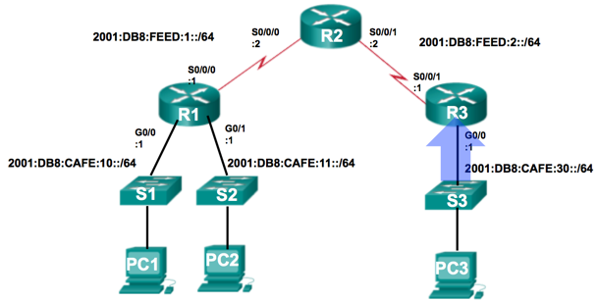
R3(config)# ipv6 access-list RETRICTED-ACCESS
R3(config-ipv6-acl)# remark Permit access only HTTP and HTTPS to Network 10
R3(config-ipv6-acl)# permit tcp any host 2001:db8:cafe:10::10 eq 80
R3(config-ipv6-acl)# permit tcp any host 2001:db8:cafe:10::10 eq 443
R3(config-ipv6-acl)# remark Deny all other traffic to Network 10
R3(config-ipv6-acl)# deny ipv6 any 2001:db8:cafe:10::/64
R3(config-ipv6-acl)# remark Permit PC3 telnet access to PC2
R3(config-ipv6-acl)# permit tcp host 2001:DB8:CAFE:30::12 host 2001:DB8:CAFE:11::11 eq 23
R3(config-ipv6-acl)# remark Deny telnet access to PC2 for all other devices
R3(config-ipv6-acl)# deny tcp any host 2001:db8:cafe:11::11 eq 23
R3(config-ipv6-acl)#remark Permit access to everything else
R3(config-ipv6-acl)#permit ipv6 any any
R3(config-ipv6-acl)#exit
R3(config)#interface g0/0
R3(config-if)#ipv6 traffic-filter RESTRICTED-ACCESS in
Notes:
Media Description:
Use 3 button graphic from powerpoint

Slide 94
Verifying IPv6 ACLs
R3# show ipv6 interface g0/0
GigabitEthernet0/0 is up, line protocol is up
Global unicast address(es):
2001:DB8:CAFE:30::1, subnet is 2001:DB8:CAFE:30::/64
Input features: Access List
Inbound access list RESTRICTED-ACCESS
<some output omitted for brevity>
R3# show access-lists
IPv6 access list RESTRICTED-ACCESS
permit tcp any host 2001:DB8:CAFE:10::10 eq www sequence 20
permit tcp any host 2001:DB8:CAFE:10::10 eq 443 sequence 30
deny ipv6 any 2001:DB8:CAFE:10::/64 sequence 50
permit tcp host 2001:DB8:CAFE:30::12 host 2001:DB8:CAFE:11::11 eq telnet sequence 70
deny tcp any host 2001:DB8:CAFE:11::11 eq telnet sequence 90
permit ipv6 any any sequence 110
R3#
Notes:
Media Description:
Use 3 button graphic from powerpoint

Slide 95
Verifying IPv6 ACLs
R3# show running-config
<some output omitted for brevity>
ipv6 access-list RESTRICTED-ACCESS
remark Permit access only HTTP and HTTPS to Network 10
permit tcp any host 2001:DB8:CAFE:10::10 eq www
permit tcp any host 2001:DB8:CAFE:10::10 eq 443
remark Deny all other traffic to Network 10
deny ipv6 any 2001:DB8:CAFE:10::/64
remark Permit PC3 telnet access to PC2
permit tcp host 2001:DB8:CAFE:30::12 host 2001:DB8:CAFE:11::11 eq telnet
remark Deny telnet access to PC2 for all other devices
deny tcp any host 2001:DB8:CAFE:11::11 eq telnet
remark Permit access to everything else
permit ipv6 any any
Notes:
Media Description:
Use 3 button graphic from powerpoint

